Slide 1

Working with Embeddings Part 2

Slide 2
Alain de Botton
“The problem isn't so much finding good ideas (there is no shortage) as embedding the ones we have into everyday practice.”

Slide 3



Notes:
https://www.youtube.com/channel/UC35ZpwldGw7ZJ5R-2sLijzw

Slide 4
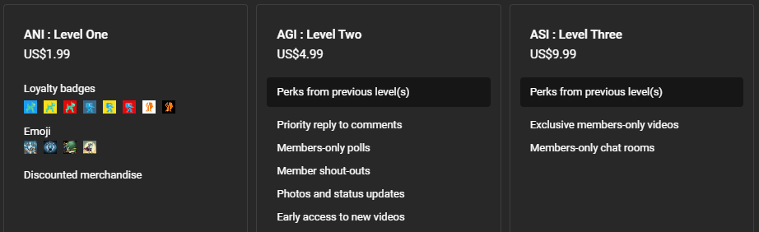
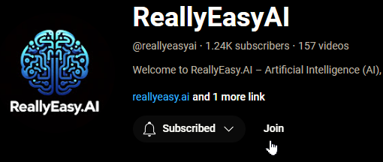
Membership has its privileges
Notes:
https://www.youtube.com/channel/UC35ZpwldGw7ZJ5R-2sLijzw/join

Slide 5
Embedding Arguments
Modifying the Embedding Space
Notes:
https://platform.openai.com/docs/api-reference/embeddings/create

Slide 6
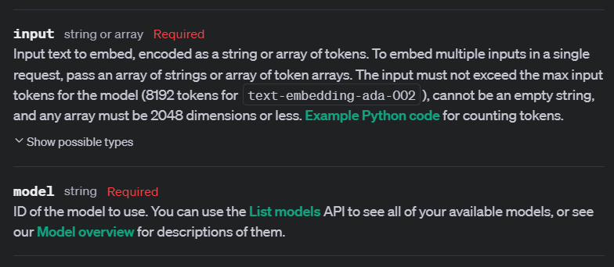
Input (String or Array) Model (String)
Notes:
https://platform.openai.com/docs/api-reference/embeddings/create#embeddings-create-input
https://platform.openai.com/docs/api-reference/embeddings/create#embeddings-create-model

Slide 7
Demo: Input and Model
# Create an embedding for the word "Mary" using the text-embedding-3-small model
response_small = client.embeddings.create(
input="Mary",
model="text-embedding-3-small"
)
# Create an embedding for the word "Mary" using the text-embedding-3-large model
response_large = client.embeddings.create(
input="Mary",
model="text-embedding-3-large"
)

Slide 8
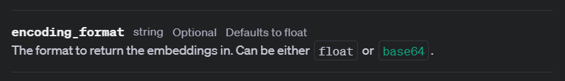
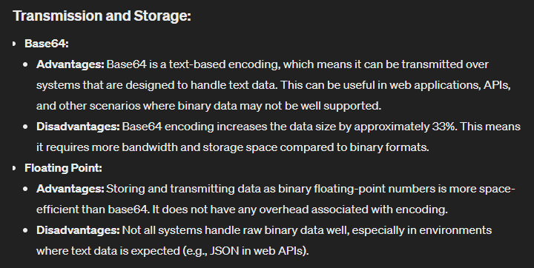
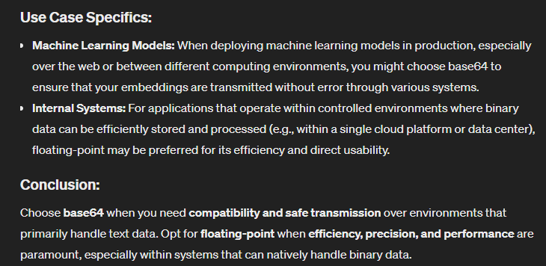
Encoding_Format (String)

Slide 9
Demo: Encoding_Format
# Encoding example
response_small = client.embeddings.create(
input=inputs,
model="text-embedding-3-small",
encoding_format="float",
)

Slide 10
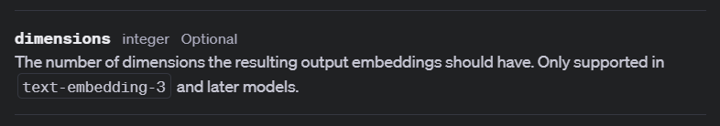
Dimensions (Integer)
Notes:
https://platform.openai.com/docs/api-reference/embeddings/create#embeddings-create-dimensions
https://arxiv.org/abs/2205.13147

Slide 11
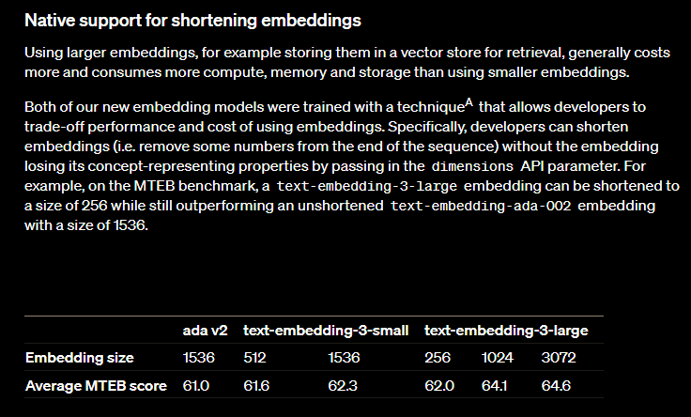

Slide 12
Demo: Dimensions
# Modify dimensions
response_small = client.embeddings.create(
input=inputs,
model="text-embedding-3-small",
encoding_format="float",
dimensions=2,
)

Slide 13
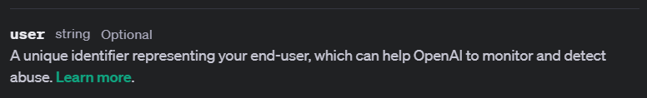
User (String)
Notes:
https://platform.openai.com/docs/api-reference/embeddings/create#embeddings-create-user

Slide 14


